Slide 1
IMAGE COMPRESSION USING MATLAB
Geetansh Garg : 19105005
Celina : 19105040
Akhil : 19105042
Rohan Sonthwal: 19105045
Prasant Kumar : 19105050
Rahul Tikoo : 19105052
Shubham Pokhriyal : 19105056

Slide 2
Overview
Multimedia images have become a vital and ubiquitous component of everyday life.
The amount of information encoded in an image is quite large.
The objective of image compression is to reduce irrelevance and redundancy of the image data to be able to store or transmit data in an efficient form.

Slide 3
Objectives
To reduce image size without affecting image quality.
To save memory
To achieve high compression ratio.
To minimize the bit rate of the compressed output without any distortion of the image.
To obtain high PSNR in compressed image.

Slide 4
What is an Image?
An image is a rectangular array of dots, called pixels. The size of the image is the number of pixels (width x height). Every pixel in an image is a certain color.
Black and white image: Each pixel is either totally white, or totally black.
Grayscale images: Use 8 bits per pixel.
Color images: The human eye can distinguish about 224 colors, although some claim that the number of colors the eye can distinguish is much higher. The most common color depths are 8, 16, and 24.

Slide 5
Color Image
There are two basic ways to store color information in an image:
Represent each pixel's color by giving an ordered triple of numbers: It is the combination of red, green, and blue that comprise that particular color.
The second way to store information about color is to use a table to store the triples, and use a reference into the table for each pixel requirements of an image. This can markedly improve the storage.

Slide 6
Why need of image compression
Productivity: The first picture information produced by the camera sensor is extensive to store.
Efficiency: In our high stress, high productivity society, most people do not have the time or patience to wait for extended periods of time while an image is downloaded or retrieved.
Transmission: If an image is compressed at a ratio of 100:1, it may be transmitted in one hundredth of the time, or transmitted at the same speed through a channel of one-hundredth the bandwidth
Since images have become so commonplace and so essential to the function of computers, it is hard to see how we would function without them.

Slide 7
Image Compression
This is done by removing all redundant or unnecessary information. An uncompressed image requires an enormous amount of data to represent it. Example: Google.com banner
When talking about images there are three main sources of redundant information:
Coding Redundancy- This refers to the binary code used to represent grey values.
Inter pixel Redundancy- This refers to the correlation between adjacent pixels in an image
Psycho visual Redundancy - This refers to the unequal sensitivity of the human eye to different visual information.

Slide 8
Types of Compression System
There are two types of compression you can pick when optimizing your images:
Lossy compression techniques can be used in image where some of the finer details in the image can be sacrificed for the sake of saving a little more bandwidth or storage space.
Lossless Compression System aims at minimizing the bit rate of the compressed output without any distortion of the image. The decompressed bit-stream is identical to original bitstream.

Slide 9
Advantages And Disadvantages
Lossy compression:
Benefit: It significantly reduces the size of the image file.
Trade-off: Reduction in size is achieved with a loss of quality.
Lossless compression:
Benefit: It allows you to retain the quality of your images while reducing their file size.
Trade-off: You will have larger files. So you will need to find other ways to optimize performance
In comparing how much compression one algorithm achieves verses another, many people talk about a compression ratio. A higher compression ratio indicates that one algorithm removes more redundancy than another (and thus is more efficient).

Slide 10
Types of image
Raster
Vector
A raster image is made of a collection of dots called pixels. A 72 dpi image is made of 72 dots-per-inch (dpi) or 72 pixels (ppi) in every inch of that image.
The number of pixels that comprise a raster image is called the resolution and it is fixed. If you take a 72 dpi image and scale it up 300%, you will not increase the number of pixels or dots of that image, you will simply increase the size of each pixel or dot. The result will be an image where you can clearly see the pixels and no fine detail. This is why it is recommended to use a high dpi like 300 at size as to get a quality image.
Raster images are generally used for photography or illustrations that have been scanned, or photos from cameras and phones that work with a raster-based program like photoshop.
A vector image is made of paths. A path can be a line, a square or a shape. Paths are used to render typography and to create anything from simple diagrams to complex illustrations. Paths are not fixed.
Vector images are ideal for when detail preservation is critical as in text, logos and flat illustrations.
Vector images can be scaled to a larger size and do not lose any image quality because they are made of paths and not dots (pixels).

Slide 11
Raster file formats
Vector file formats
JPEG
TIFF
PNG
GIF
RAW
PSD
PDF
EPS
SVG
AI

Slide 12
Representation
There are a large number of file formats (hundreds) used to represent an image, some more common than others. Among the most popular are:
GIF: Graphics Interchange Format. The most common image format on the Web. Stores 1 to 8-bit color or grayscale images.
TIFF: Tagged Image File Format. The standard image format found in most paint, imaging, and desktop publishing programs. Supports 1- to 24- bit images and several different compression schemes.
PICT: MacIntosh's native image file format, produced by many programs that run-on Macs. Stores up to 24-bit color.
BMP: Microsoft Windows Bitmap. Main format supported by Microsoft Windows. Stores 1-,4-, 8-, and 24-bitimages.
JPEG File Interchange Format Developed by the Joint Photographic Experts Group, sometimes simply called the JPEG file format. It can store up to 24-bits of color.
PNG stands for “Portable Graphics Format”. It is the most frequently used uncompressed raster image format on the internet.

Slide 13
JPEG
JPEG is a lossy raster format that stands for Joint Photographic Experts Group, the technical team that developed it. This is one of the most widely used formats online, typically for photos, email graphics and large web images like banner ads. JPEG images have a sliding scale of compression that decreases file size tremendously, but increases artifacts or pixelation the more the image is compressed.
You should use a JPEG when…
You’re dealing with online photos and/or artwork. JPEGs offer you the most flexibility with raster editing and compression making them ideal for web images that need to be downloaded quickly.
You need to send a quick preview image to a client.
Don’t use a JPEG when…
You need a web graphic with transparency. JPEGs do not have a transparency channel and must have a solid color background.
for medical and scientific applications where the image needs to be accurate and a slight error cannot result in the retrieval of the captured data.

Slide 14
tiff
TIFF is a lossless raster format that stands for Tagged Image File Format. Because of its extremely high quality, the format is primarily used in photography and desktop publishing. You’ll likely encounter TIFF files when you scan a document or take a photo with a professional digital camera.
You should use a TIFF when…
need high-quality print graphics.
You are making a high-quality scan.
Don’t use at TIFF when…
You’re working with web graphics. While many web browsers support it, TIFF files are optimized for print. Go with JPEG or PNG when you need to display high-quality images online.

Slide 15
PNG
PNG is a lossless raster format that stands for Portable Network Graphics. Think of PNGs as the next-generation GIF. This format has built-in transparency, but can also display higher color depths, which translates into millions of colors. PNGs are a web standard and are quickly becoming one of the most common image formats used online.
You should use a PNG when…
You need high-quality transparent web graphics.
You have illustrations with limited colors. Though any image will work, PNG files are best with a small color palette.
You need a small file. PNG files can shrink to incredibly tiny sizes—especially images that are simple colors, shapes or text. This makes it the ideal image file type for web graphics.
Don’t use a PNG when…
You’re working with photos or artwork.
You’re dealing with a print project.

Slide 16
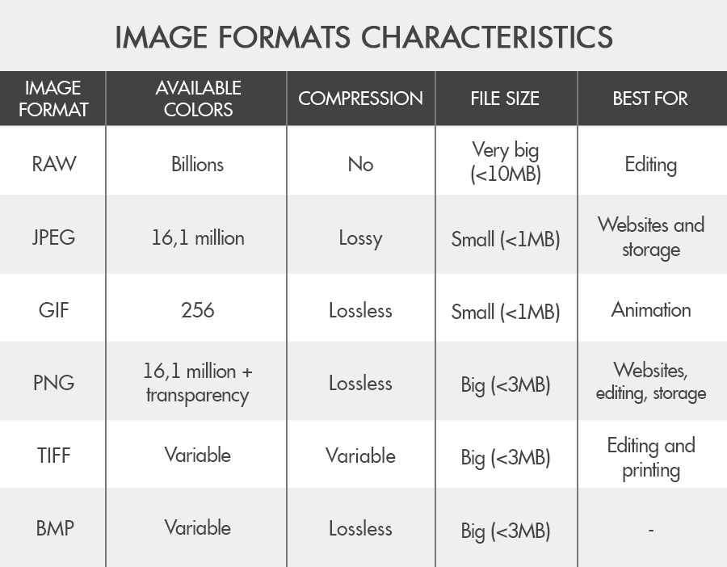

Slide 17
IMAGE COMPRESSION MODEL
Athough image compression models differ in the way they compress data, there are many general features that can be described which represent most image compression algorithms. The source encoder is used to remove redundancy in the input image. The channel encoder is used as overhead in order to combat charnel noise. A common example of this would be the introduction of a parity bit. By introducing this overhead, a certain level of immunity is gained from noise that is inherent in any storage or transmission system. The channel in this model could be either a communication link or a storage/retrieval system. The job of the channel and source decoders is to basically undo the work of the source and channel encoders in order to restore the image to the user.

Slide 18
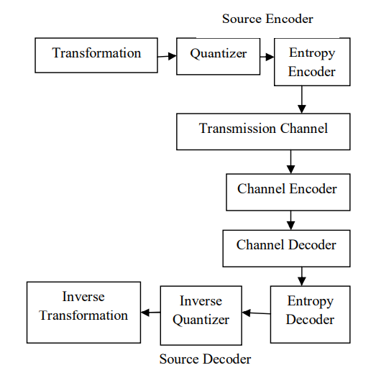
Components of Typical Image Transmission

Slide 19
TECHNIQUES USED FOR IMAGE COMPRESSION

Slide 20
Image Compression Model
Image compression system deals with reducing the amount of data required to represent a digital image.
Composed of two distinct functional components:
Encoder - performs the complementary operation of compression
Decoder - performs the complementary operation of decompression
Image compression and decompression can be performed in
Software - web browsers , commercial image editing programs
Hardware and firmware - commercial DVD players
Codec

Slide 21
Input image f(x, y) is fed into the encoder which creates a compressed representation of the input.
This representation is stored for latter use, or transmitted for storage and use at a remote location.
When the compressed representation is presented to its complementary decoder, a reconstructed output image f^(x, y) is generated.
f(x, y) – input, f^(x, y) – output
If f^(x, y) is a replica of f(x, y) - error free, lossless or information preserving compression system.
If not, the reconstructed output image is distorted and the compression system is referred to as lossy.

Slide 22
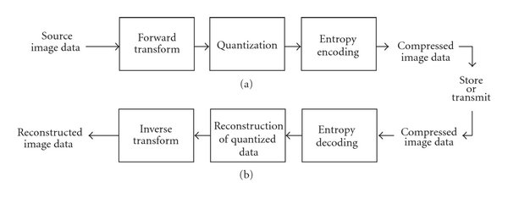
Components of Typical Image/Video Transmission

Slide 23
The Encoding or Compression Process
Spatial-domain to frequency-domain transformation to reduce the redundancies.
Consists of three main components: the transform, the quantizer and the binary encoder
Transform:
Mapper transforms f(x, y) into a format designed to reduce spatial and temporal redundancy
Permits the quantizer and binary encoder to be more effective.
May or may not reduce directly the amount of data required to represent the image
Quantizer:
Reduces the accuracy of the mapper’s output in accordance with per-established fidelity criterion
lossy or noninvertible operation
Must be omitted when error-free compression is desired

Slide 24
Binary Encoder:
Symbol coder generates a fixed or variable length code to represent the quantizer output
Maps the output in accordance with the code
Minimized coding redundancy
Shorter codewords allows to achieve additional compression
Irreversible operation
Image is processed for the removal of:
Coding redundancies
Inter pixel redundancies
Psycho visual redundancies

Slide 25
The Decoding or Decompression Process
Consists of two components: binary decoder, inverse transform
Binary decoder:
Inverts the operation of the binary encoder
Produces the levels originally produced by the quantizer
Quantization operation is irreversible so inverse quantizer block is not included.
Inverse transform:
Performs the inverse of the encoding transform
Output of the decoder (encoded or decoded image or reproduction) can be displayed on a monitor or printed on paper, as desired.

Slide 26
Image Compression Algorithms:

Slide 27
Image Compression Algorithms:
Lossless compression is sometimes preferred for artificial images, because used when at low bit rates, introduce compression artifacts. Lossless compression methods may also be preferred for high value content, such as medical imagery or image scans.
Lossy compression is the class of data encoding methods that uses inexact approximations and partial data discarding to represent the content. These techniques are used to reduce data size for storing, handling, and transmitting content

Slide 28
Various Lossy Compression Methods are:
Cartesian Perceptual Compression(CPC)
Fractal compression
JPEG and JPEG 2000
PGF.

Slide 29
Various Loss-Less Compression Method
Run-length encoding
Entropy coding
Adaptive dictionary algorithms
Deflation

Slide 30
Steps involved in Compressing and Decompressing of Image
Specify the Rate and Distortion parameters for the target image.
Dividing the image data into various classes.
Dividing the available bit budget among these classes.
Quantize each class separately using bit allocation.
Encode each class separately using an entropy coder
Reconstructing the image from the compressed data.
Read the quantized data from the file, using an entropy decoder.
Dequantized the data.
Rebuild the image.

Slide 31
Image compression using WAVELETS

Slide 32
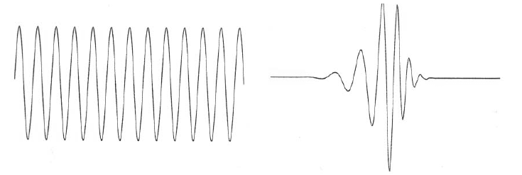
What is a wavelet?
A function that waves above and below the x-axis with the following properties:
Varying frequency
Limited duration
Zero average value
Unlike sinusoids, used by FT, which have infinite duration and constant frequency.
Sinusoid Wavelet

Slide 33
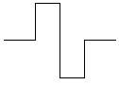
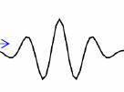
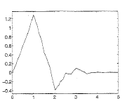
Types of Wavelets
There are many different wavelets, for example:
Haar
Morlet
Daubechies

Slide 34
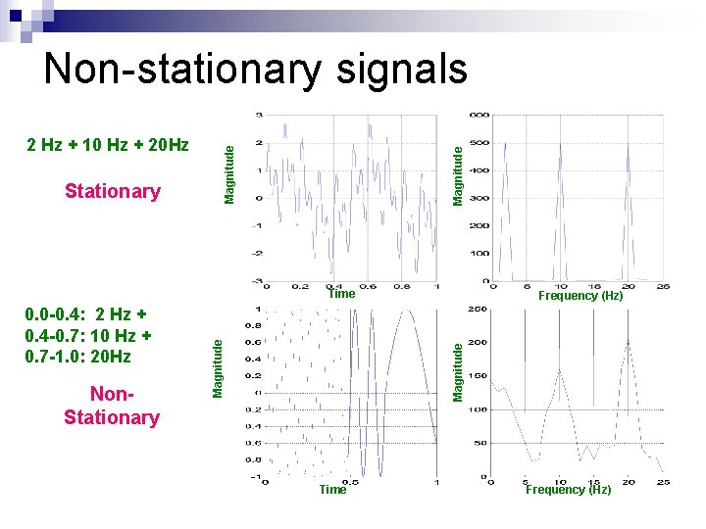
What is a wavelet transform ?
Wavelet Transform is a method of representing time-frequency signals from wavelet transform
Wavelet Transform over Fourier Transform ?
Fourier transform is a powerful tool for analyzing the components of a stationary signal but it is failed for analyzing the non-stationary signals whereas wavelet transform allows the components of a non-stationary signal to be analyzed.

Slide 35
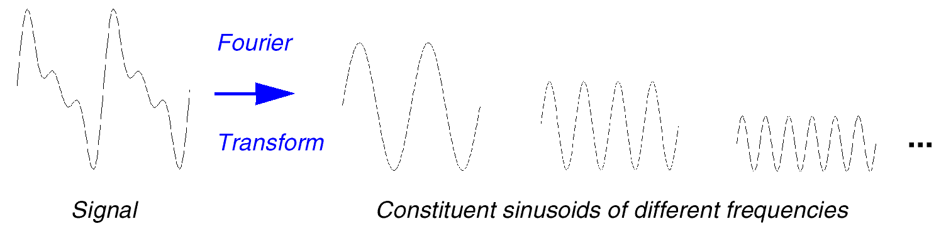
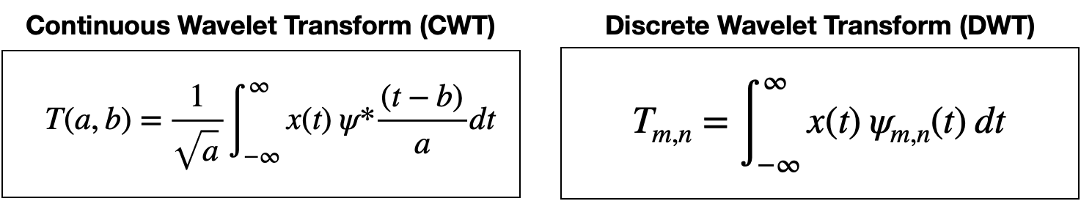

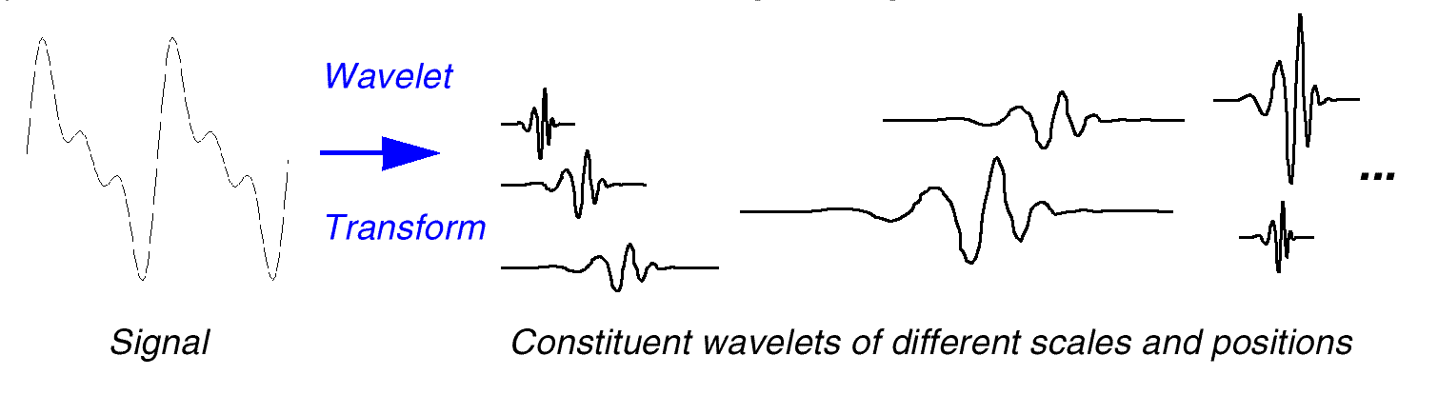
Fourier Transform vs Wavelet Transform

Slide 36

Continuous Wavelet Transform (CWT)
translation parameter (measure of time)
scale parameter
(measure of frequency)
scale =1/2^{j}
(1/frequency)
Forward
CWT:
mother wavelet (i.e., window function)
normalization
constant

Slide 37
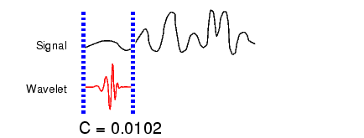

Illustrating CWT
Take a wavelet and compare it to a section at the start of the original signal.
Calculate a number, C, that represents how closely correlated the wavelet is with this section of the signal. The higher C is, the more the similarity.

Slide 38
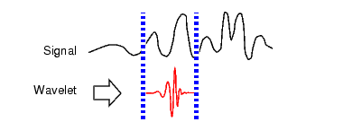

Illustrating CWT
3. Shift the wavelet to the right and repeat step 2 until you've covered the whole signal.

Slide 39
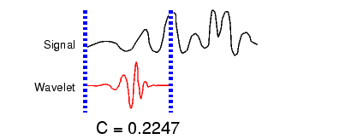

Illustrating CWT
4. Scale the wavelet and go to step 1.
5. Repeat steps 1 through 4 for all scales.

Slide 40
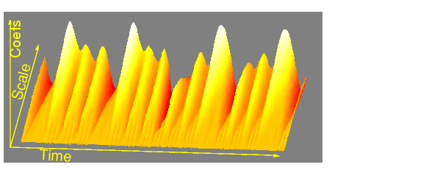

Visualize CTW Transform
Wavelet analysis produces a time-scale view of the input signal or image.

Slide 41
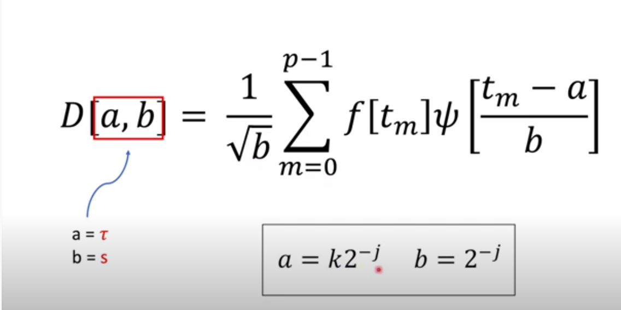
Discrete Wavelet Transform (DWT)
Calculating wavelet coefficients at every possible scale produces a lot of data
If a and b chosen to be discrete then the wavelet transform won’t generate huge amounts of data
If a and b are based on power of two(dyadic) then analysis become more efficient and accurate
J is scale index
K is wavelet
Transform signal index

Slide 42
Image Compression Algorithms:
Principles behind compression?
Redundancy reduction aims at removing duplication from the signal source (image/video).
Irrelevancy reduction omits parts of the signal that will not be noticed by the signal receiver, namely the Human Visual System (HVS).

Slide 43
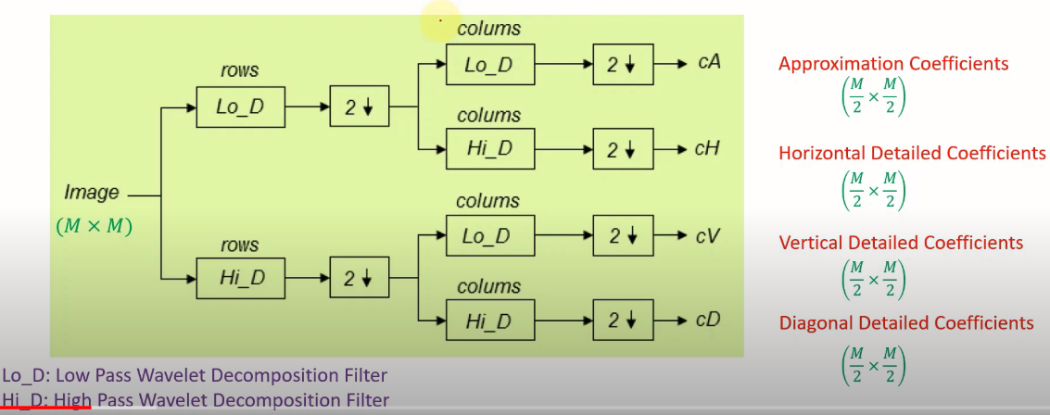
2-D DWT for Image

Slide 44
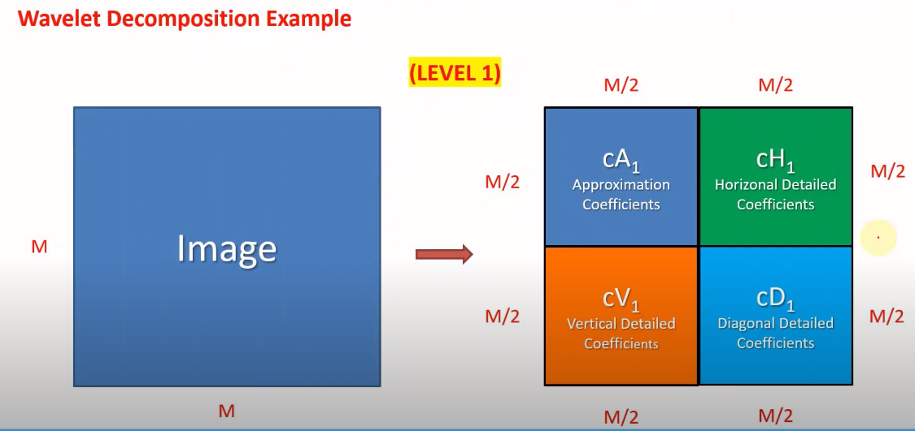
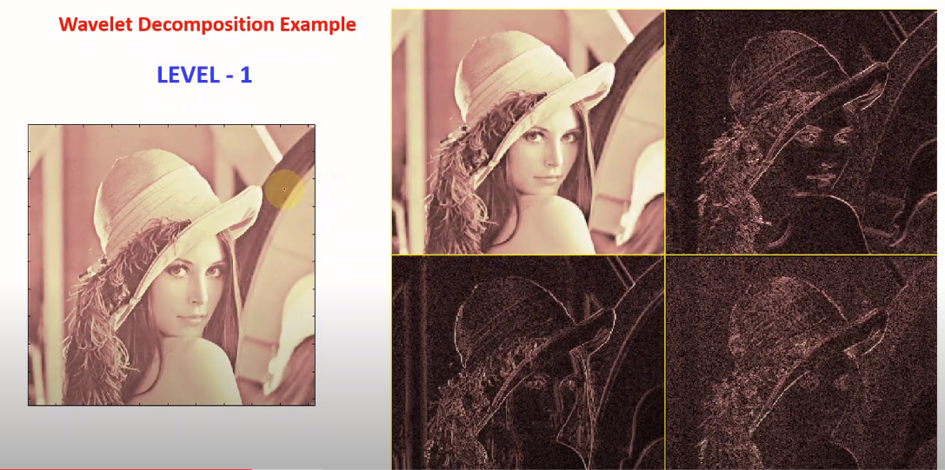
LL
HL
LH
HH

Slide 45
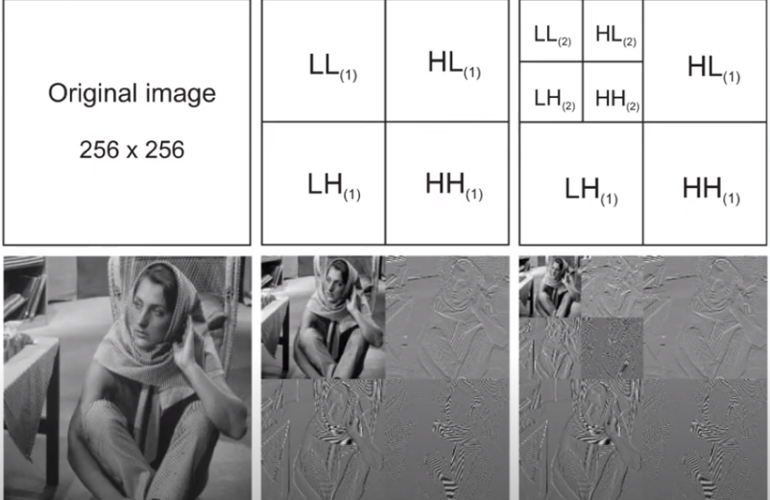

Slide 46
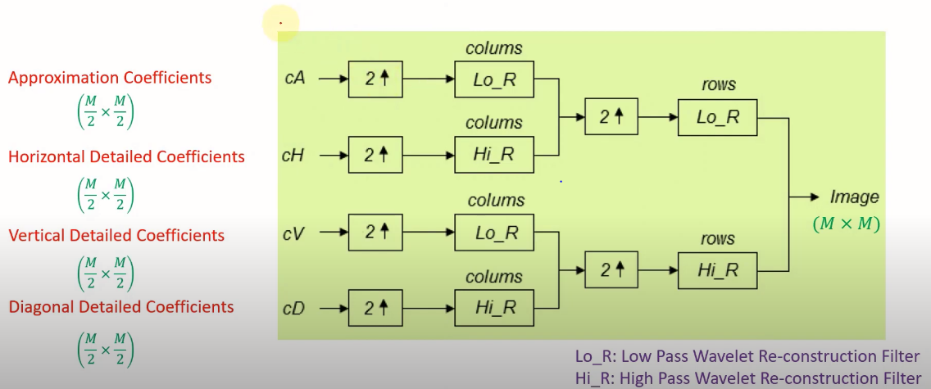
WAVELET RECONSTRUCTION

Slide 47
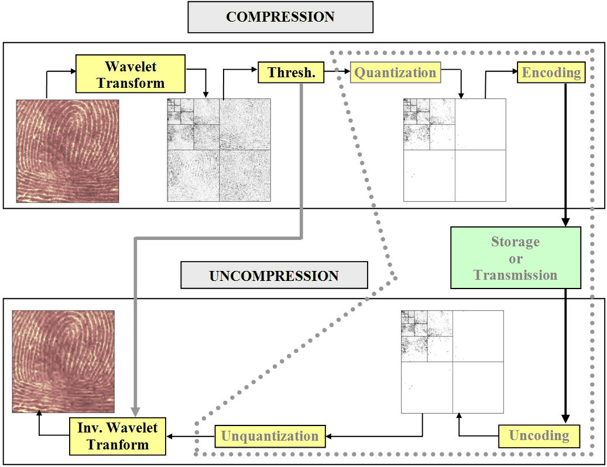

Slide 48
Image compression using DCT

Slide 49
What is DCT?
DCT stands for Discrete Cosine Transform .
It represents an image as a sum of sinusoids of varying magnitudes and frequencies .
DCT is an outcome of the efforts to make DFT(Discrete Fourier Transform) having real values instead of complex values .
DCT coefficients are real valued while DFT coefficients are complex , therefore , hardware implementation of DCT is easier than DFT .

Slide 50
DCT-(continued..)
DCT is equivalent to computing 2N-point DFT of signal which is made even symmetric by its extension .
Where N point DFT of a sequence x[n] is given by -
X[k] = Σ x[n]*exp(-j2πk *n/N) ; over n=0 to N-1.

Slide 51
DCT-(continued)
DCT has the property that , for a typical image , most of the visually significant information about the image is concentrated in just a few coefficients of the DCT . This property is known as ENERGY COMPACTION property .Hence, DCT finds it's importance in image compression technique .

Slide 52
Various Applications of DCT-
DCT has vast applications areas, such as -
Image Compression: JPEG, HEIF ,WebP , BPG etc.
Video Compression: H.261 ,MJPEG , MPEG1 ,H.262(MPEG2) ,H.263 , H.264(AVC MPEG4) , H.265(HEVC) , WebM , etc.

Slide 53
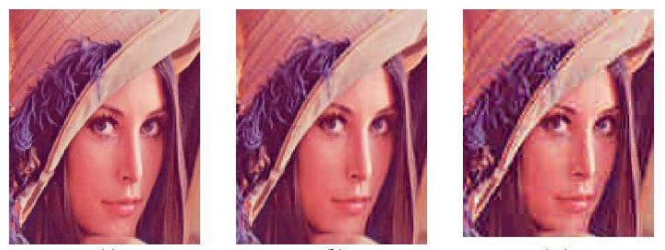
Issues With DCT -
A common issue with DCT compression in digital media are BLOCKY COMPRESSION ARTIFACTS , caused by DCT blocks. The DCT algorithm can cause block-based artifacts when heavy compression technique is applied .

Slide 54
Issues With DCT -(Continued)
Truncation of higher spectral coefficients results in blurring of the images , especially wherever the details are high .
Coarse quantization of some of the low spectral coefficients introduces graininess in the smooth portions of the image .

Slide 55
2D-FDCT (2Dimensional Forward DCT)
The two dimensional DCT of an M*N image f(x, y) is as follows-
F(p ,q) =αp*αq ΣΣ f(x ,y) cos[π(2x+1)p/2M] cos[π(2y+1)q/2N]
Where 0 ≤ p ≤ M-1 and 0 ≤ q ≤ N-1 and
αp = 1/sqrt(M) ; p=0
=sqrt(2/M); 1 ≤ p ≤ M-1 ;
αq = 1/sqrt(N) ; q=0
=sqrt(2/N); 1≤ q ≤ N-1 ;

Slide 56
2D DCT Basis Functions
From the 2D FDCT and the 2D-inverse DCT(IDCT) we find the term:-
αp*αq cos[π(2x+1/2M)]cos[π(2y+1)q/2N]
Common and same in both the expressions . These functions are called as BASIS FUNCITONS OF DCT .

Slide 57
Basis Functions-(Continued)
The Basis functions for 8 * 8 matrix are shown -
Horizontal frequencies increase from the left to right , and vertical frequencies increase from the top to bottom .
The constant valued basis function at the upper left is called as DC basis function and corresponding coefficient is called DC coefficient. Rest of the coefficients are called AC coefficients .

Slide 58
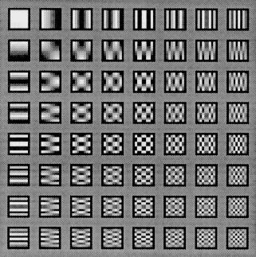
DCT basis functions

Slide 59
Computing DCT of an Image
There are two ways to computer DCT of an Image –
TRANSFORMATION MATRIX APPROACH
FFT Based approach
TRANSFORMATION AMTRIX APPROACH -
This method is suitable for small image segments such as 8*8 ,16*16 ,etc. For this , a DCT transformation matrix T is computed first for M *M segment by the following equation-

Slide 60
Transformation matrix approach(continued)
T = 1/sqrt(M); p=0; 0 ≤ q ≤ M-1 ;
= sqrt(2/M)cos[π(2q+1)p/2M]; 1≤ p ≤ M-1; 0≤ q ≤ M-1 ;
When transformation matrix T is computed then , DCT of an image segment f(x,y) can be found as -
F(p,q) = T *f(x,y)*T'; where T' is the transpose matrix.
Since T is real orthonormal , its inverse is equivalent to its transpose ,therefore , inverse DCT is found by -

Slide 61
Transformation matrix approach(continued)
F(x,y) = T' * F(p,q) *T
In MATLAB , DCT transformation matrix T can be computed using dctmtx() function.

Slide 62
FFT based approach -
It utilizes the FFT structure for speedy computation of DCT , hence suitable for large input images .
In MATLAB it is achieved by using dct2() fucntion .
Since DCT has very good energy compaction capability , it means that the information is being carried by fewer DCT coefficients , and therefore , large amount of coefficients can be neglected to achieve image compression .

Slide 63
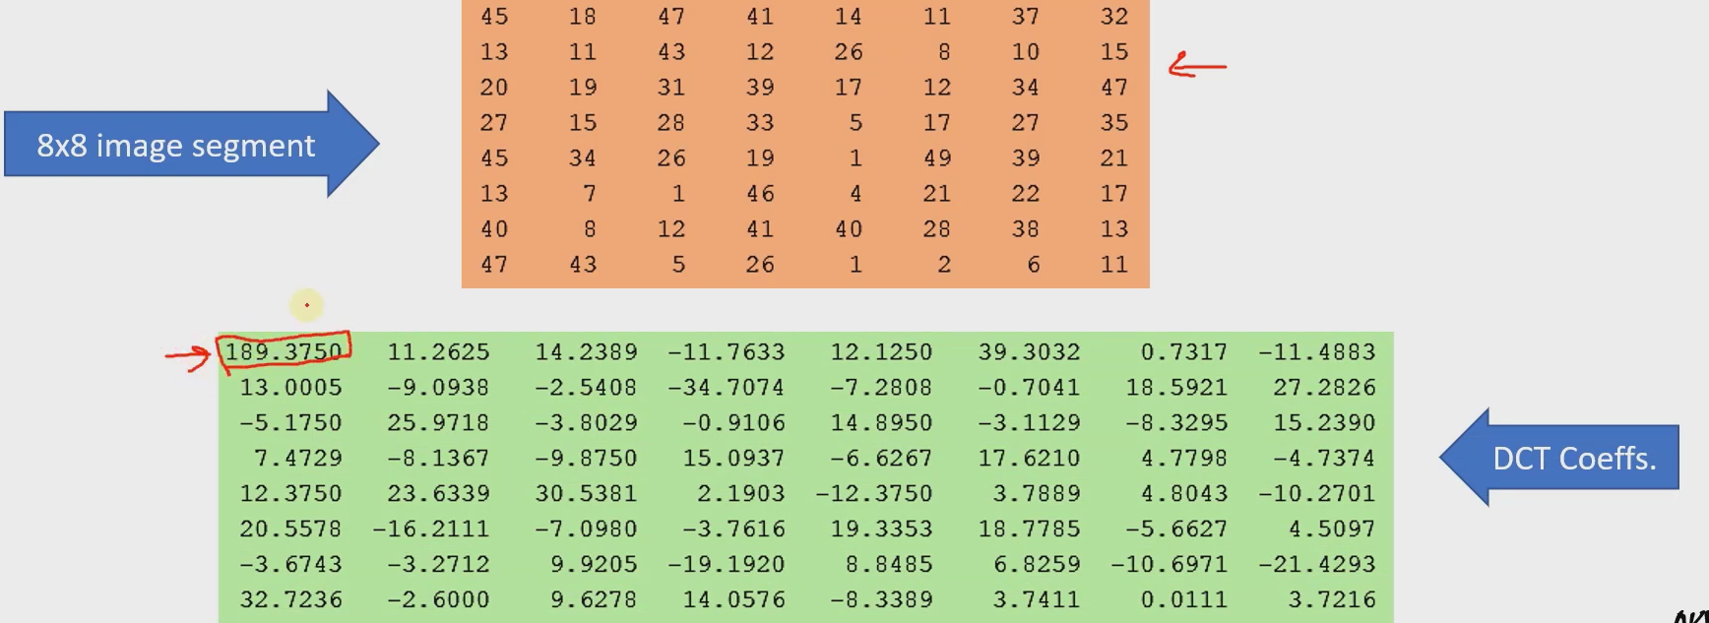

Slide 64
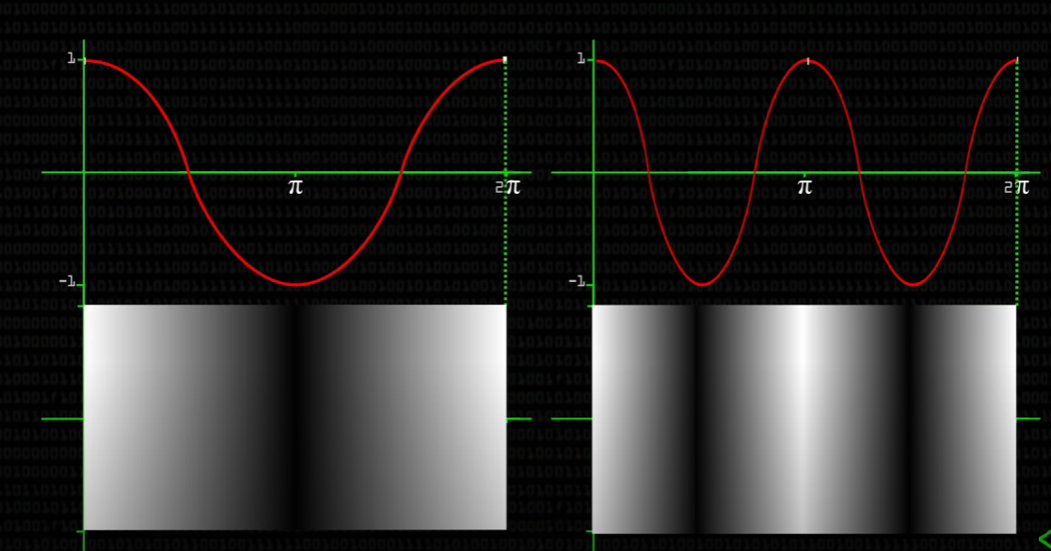
Visualizing DCT -

Slide 65
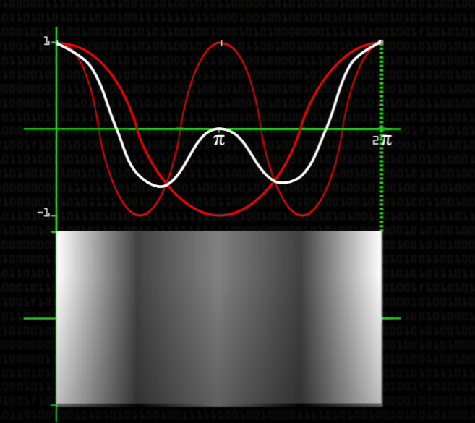
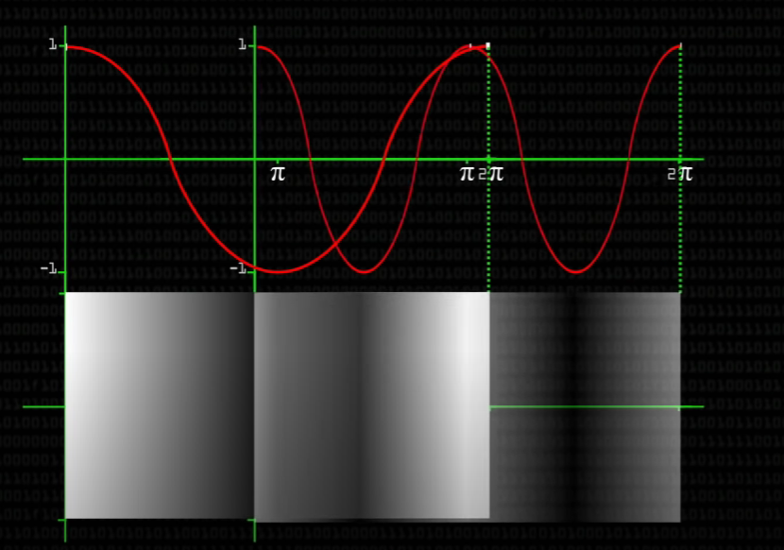

Slide 66
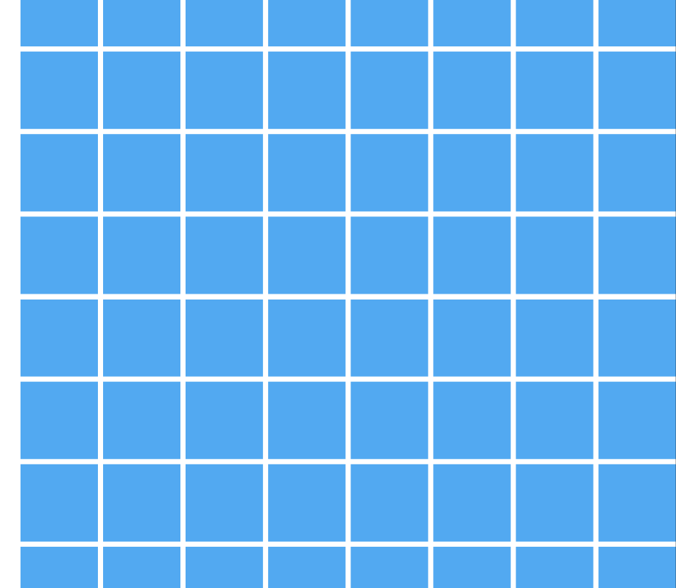
8*8 JPEG pixel groups

Slide 67
Removing High Frequency data -

Slide 68
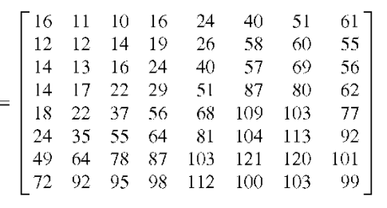
Quantization - (After DCT )
After DCT coefficients are calculated we remove the coefficients that we don’t really need (the high frequency ones ) and this process is called quantization .
A standard example of JPEG quantization table representing 50% quality

Slide 69
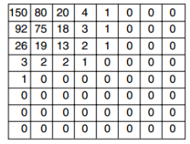
Quantization (continued)
Quantized output.
(NOTICE THE HIGHER FREQ. COMOPENETS ALMOST REDUCE TO ZERO AFTER ROUNDING OFF)

Slide 70
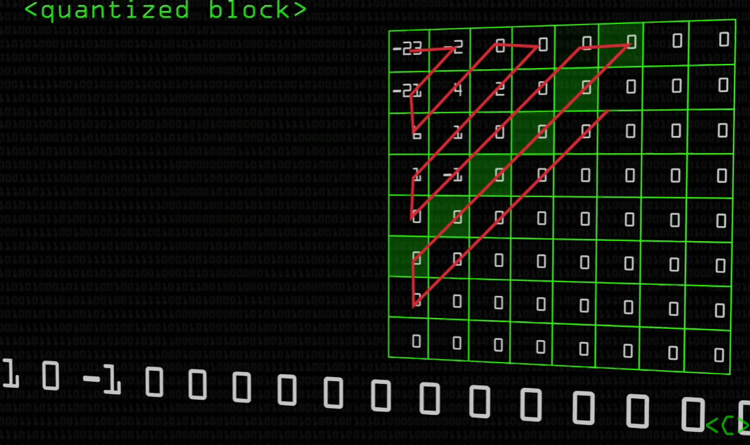
Numbers are taken in ZIG-ZAG fashion so that we get a large numbers of zeroes in the same line which is much easier to compress further using HUFFMAN CODING .

Slide 71
Conclusion
For high quality images we can use lossless compression, Ex: image of medical equipment.
High quality lossless compression could be achieved by many method such as RLE(Run length encoding) and Bit compression(Huffman encoding).

Slide 72
RLE(Run length Encoding)
For simple images computers can use a compression algorithm called RLE.
In run-length encoding, the computer replaces each row with numbers that say how many consecutive pixels are the same color, always starting with the number of white pixels.
For example, 0001100000110000 this could be represented as 3,2,5,2,4.

Slide 73
RLE decompression
When a computer uses run length encoding, it should be able to perfectly recreate the image from the compressed representation—and so should we, if we follow the computer's strategy.
For example 4,5,3 could be easily decompressed to 000011111000.
This method can significantly reduce image size while retaining 100% of its quality.

Slide 74
Bit compression(Huffman coding)
For bit compression computer can use technique called Huffman coding.
We can understand Huffman coding through following example:-
For compressing agcttttcattct,
Since we need to represent four characters, a computer would typically represent each character using 2 bits, such as:
‘a’ could be mapped with 00 , ‘c’ with 01 , ‘g’ with 10 , ‘t’ with 11

Slide 75
Bit compression (continued..)
agcttttcattct could be represented as 00100111111111010011110111.
Since ‘t’ is most common in above example ,If we give a shorter code to "t", then we'd be using less space 54% of the time (7 out of 13 characters)
For example ‘a’ could be mapped with 010, ’c’ with 00 , ‘g’ with 011, ‘t’ with 1
Through this we can reduce above code to 0100110011110001011001.
Here code after optimization is significantly shorter.

Slide 76
Lossy Compression
For lossy compression , DCT can be used.
The advantage of using this DCT representation is that it allows us to separate the low frequency changes (top left ones) from high frequency changes (bottom right), and JPEG compression uses that to its advantage. The human eye does not usually notice high frequency changes in an image so they can often be discarded without affecting the visual quality of the image. The low frequency (less varied) basis functions are far more important to an image.
JPEG compression uses a process called quantisation

Slide 77
Quantisation
Quantisation requires a quantisation table of 64 numbers. Each coefficient value is divided by the corresponding value in the quantisation table and rounded down to the nearest integer. This means many coefficients become zero, and when multiplied back with the quantisation table, remain zero.
There is no optimal quantisation table for every image, but many camera or image processing companies have worked to develop very good quantisation tables.
After applying Quantisation many zero coefficients.

Slide 78
Quantisation(continued..)
If we list the coefficients in a zig-zag, starting from the top left corner, we will end up with many zeros in a row. Instead of writing 20 zeros we can store the fact that there are 20 zeros using a method of run-length encoding very similar to the one discussed earlier.
And rest of the numbers could be converted to bits using Huffman coding.
By following above steps we can save a lot of memory.

Slide 79
Thank You

